Slide 1

Bapuji Education Association BAPUJI INSTITUTE OF ENGINEERING AND TECHNOLOGY DAVANGERE,KARNATAKA- 577004 DEPARTMENT OF COMPUTER SCIENCE AND ENGINEERING
DBMS MINI PROJECT-
“ HOSPITAL BED SLOT BOOKING SYSTEM ”
TEAM MISSION
TEAM MEMBERS PROJECT GUIDE:
Anushree B kupasthu(4BD21CS20),Champa B G(4BD21CS029), Dr.GURURAJ T
Deeksha G(4BD21CS035) ,Komal P J(4BD21CS062) associative proffesor

Slide 2
“HOSPITAL BED SLOT BOOKING SYSTEM”

Slide 3
Vision and Mission of the Institute
Vision To be a centre of excellence recognized nationally and internationally, in distinctive areas of engineering education and research, based on a culture of innovation and invention. Mission BIET contributes to the growth and development of its students by imparting a broad based engineering education and empowering them to be successful in their chosen field by inculcating in them positive approach, leadership qualities and ethical values.

Slide 4
Department Vision To be a centre-of-excellence by imbibing state-of-art-technology in the field of Computer Science and Engineering, thereby enabling students to excel professionally and be ethical. Department Mission M1:Adapting best teaching and learning techniques that cultivates Questioning and Reasoning culture among the students. . M2:Creating collaborative learning environment that ignites the critical thinking in students and leading to the innovation. M3:Establishing Industry Institute relationship to bridge the skill gap and make them industry ready and relevant. M4:Mentoring students to be socially to be socially responsible by inculcating ethical and moral values.

Slide 5
INTRODUCTION
The project Bed slot allotment system includes registration of patients, storing their
details into the system. The software has the ability to give a unique id to each patient and
stores the details of every patient. Users can search availability of the bed and the details of a patient using the id. The bed slot allotment system can be entered by using a username and password. It is accessible either by an administrator or receptionist. Only they can and data into the database. The data can be retrieved easily.
The data is very well protected for personal use. Bed slot allotment system is an integrated end to end bed slot allotment system that provides relevant information and decision making for the user in the interface for a seamless flow.

Slide 6
01
02
03
USER LOGIN
ADMIN LOGIN
HOSPITAL LOGIN
LOGIN PAGES

Slide 7
PROBLEM STATEMENT
Hospital Bed Booking Management System aims to address this challenge by providing a comprehensive solution for hospitals to manage and allocate their bed slots effectively.

Slide 8
OBJECTIVES : ● To develop a rental management system that allows the user to view customers‟ data as well as record. ● To develop a system that allows the users to add, edit, search and delete data from the database. ● To study and analyse the requirement specifications of the rental house management system.

Slide 9
REQUIRMENT
Python flask
Boot strap front-end; it’s a frame work includes HTML,CSS based design templates .
XAMPP server for my sequel data base

Slide 10
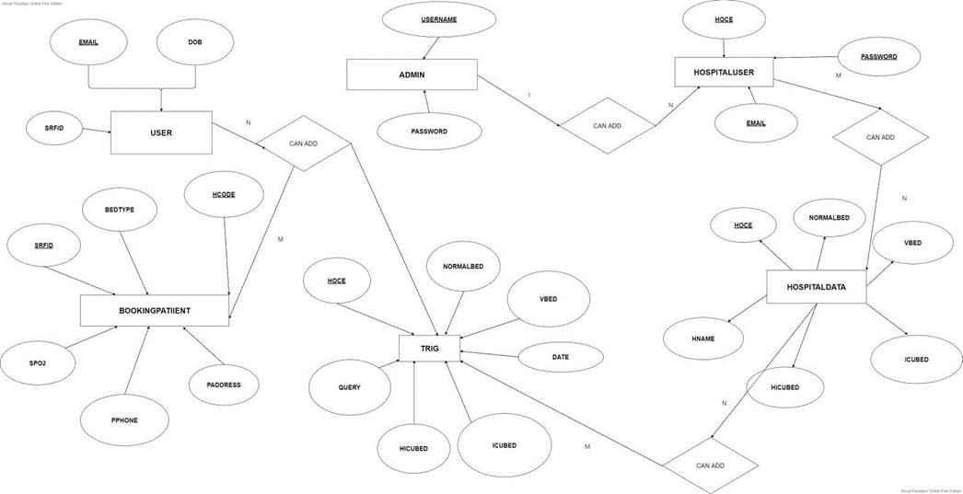
ER Diagram And description :
NEW SECTION

Slide 11
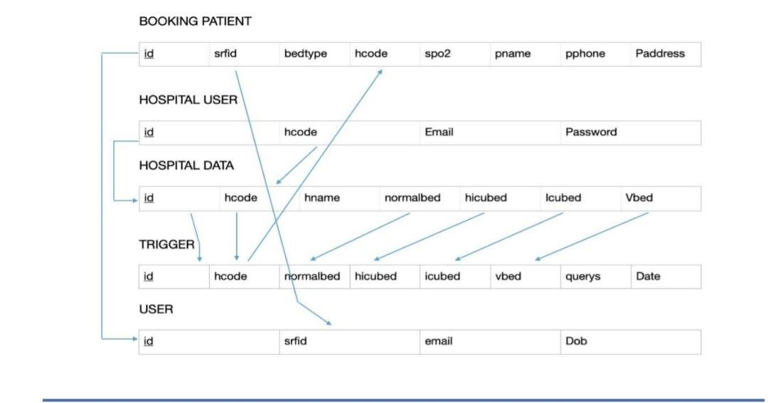
SCHEMA DIAGRAM :

Slide 12
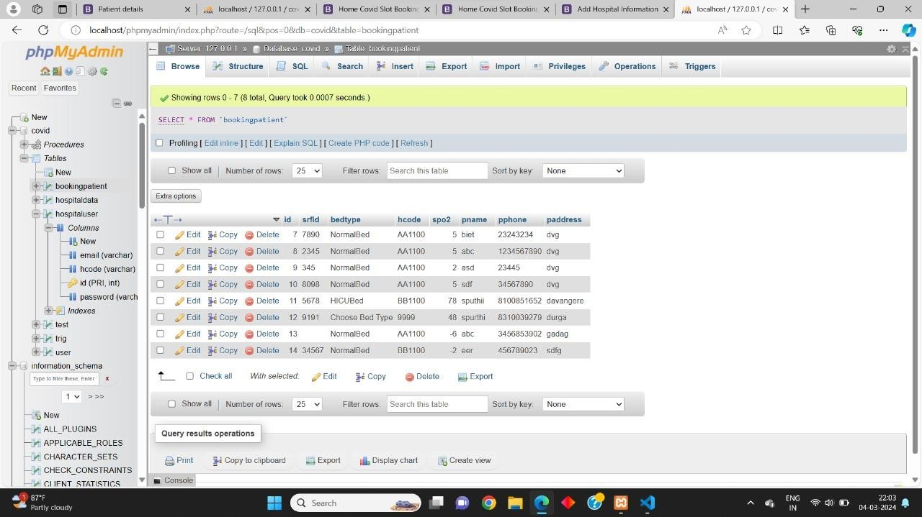
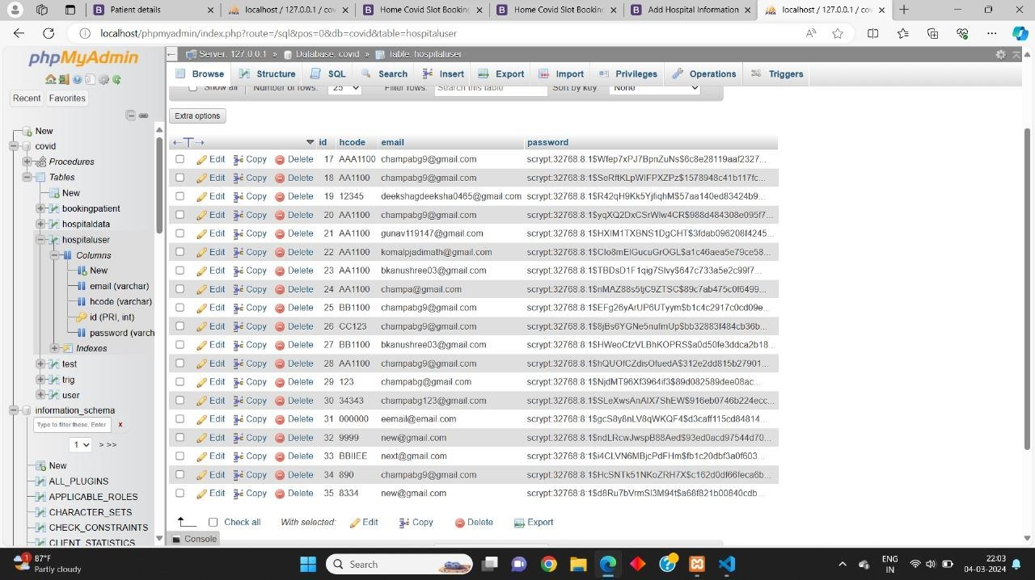
DATABASE DESCRIPTION :
1.description of booking patients 2. Hospital user table

Slide 13
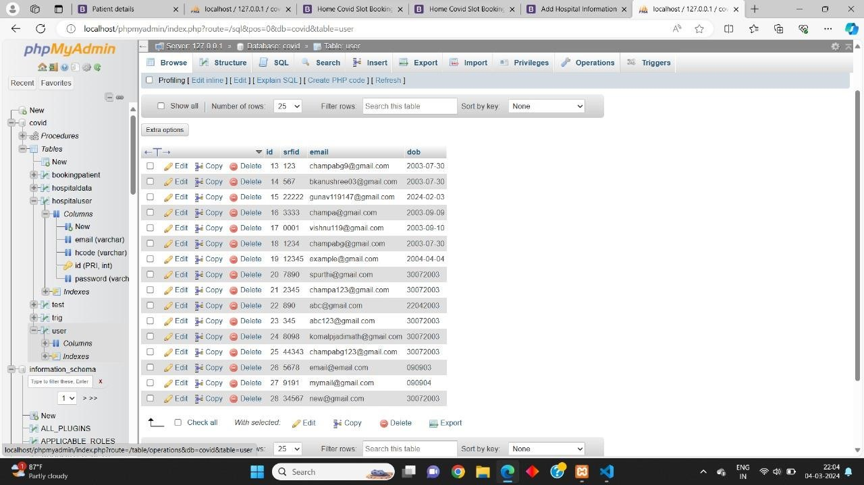
3. user table 4.hospital user table

Slide 14
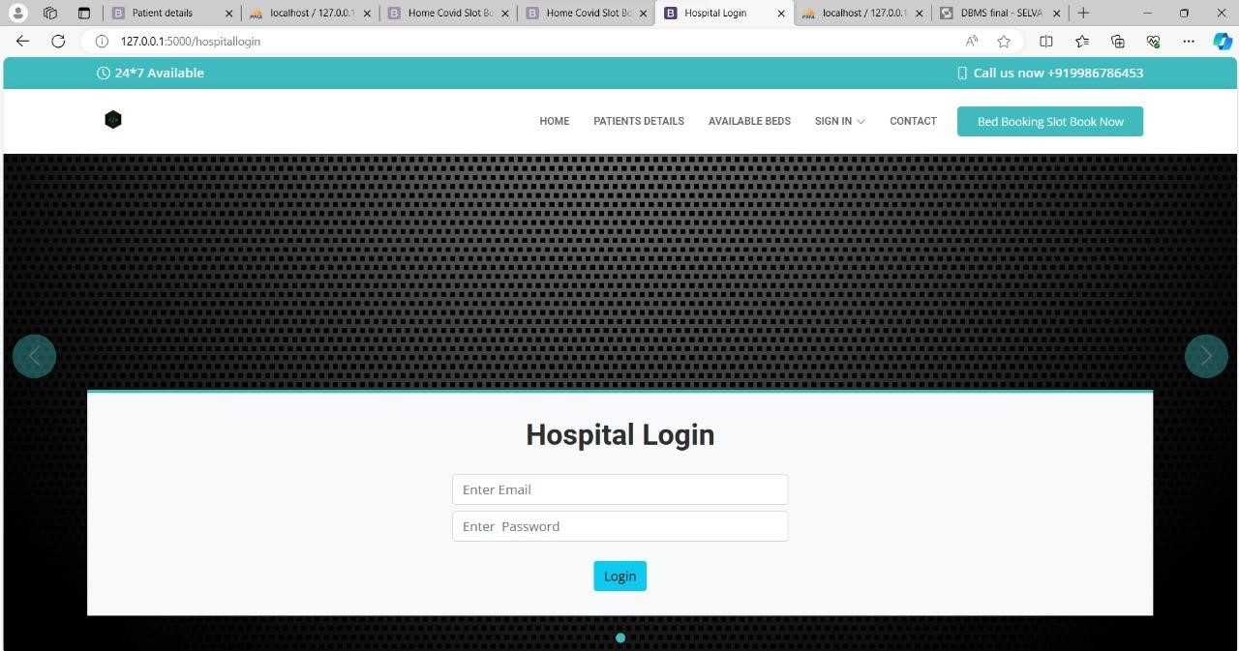
SNAPSHOTS:
Hospital Login Page

Slide 15
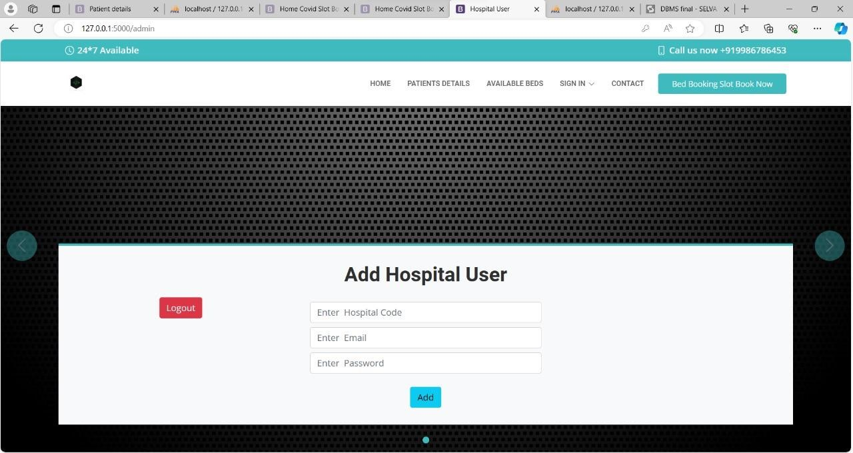
Hospital user page

Slide 16
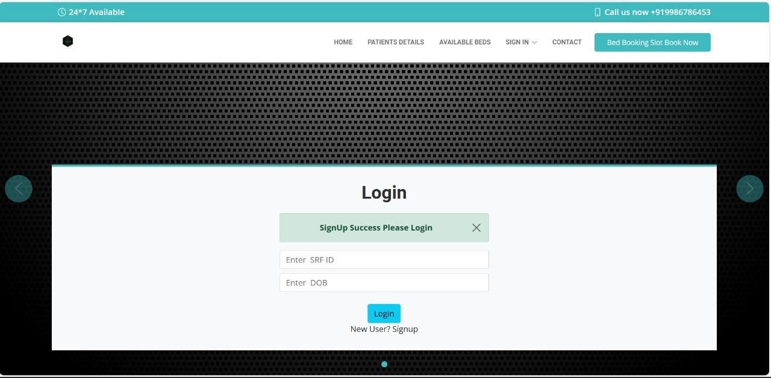
User Login Page

Slide 17
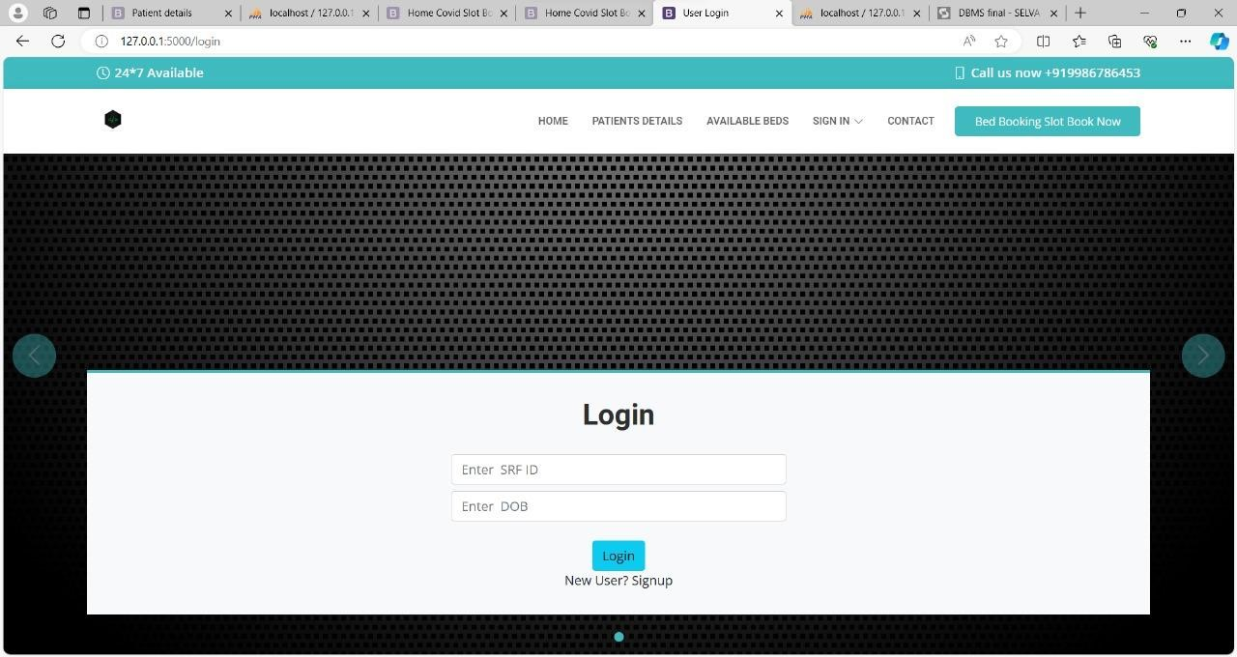
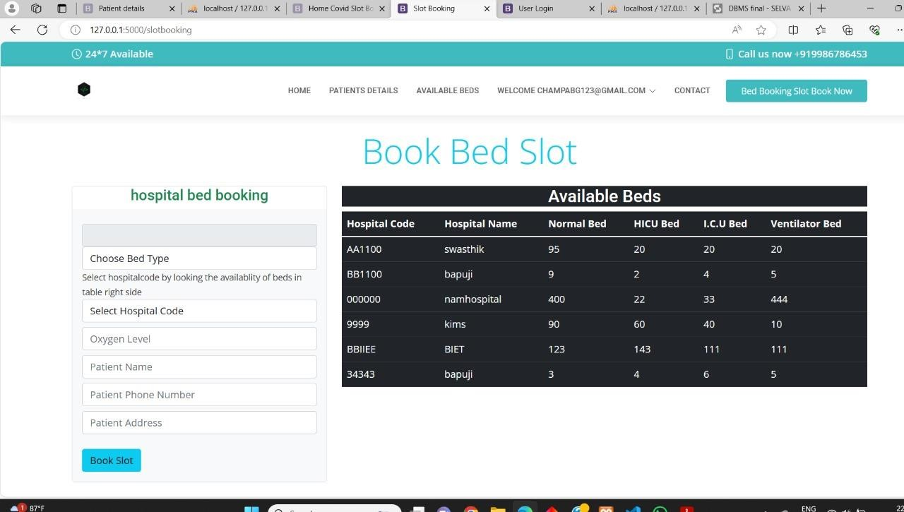
User Login Page book bed slot

Slide 18
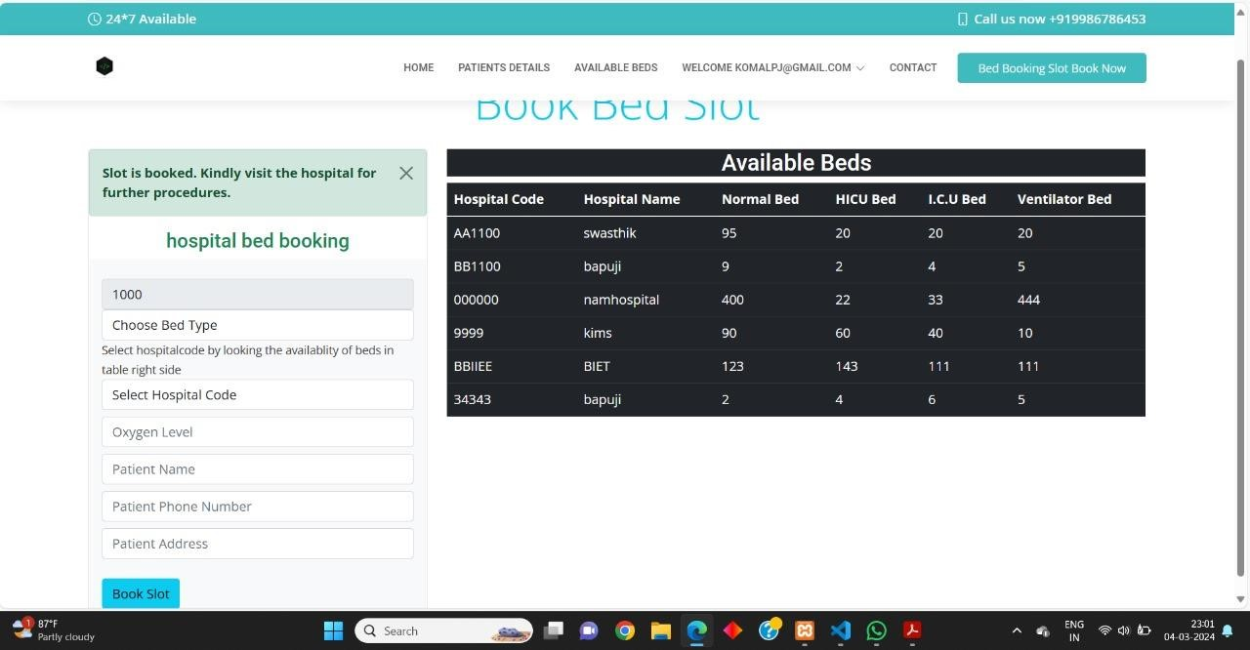
Book bed slot

Slide 19
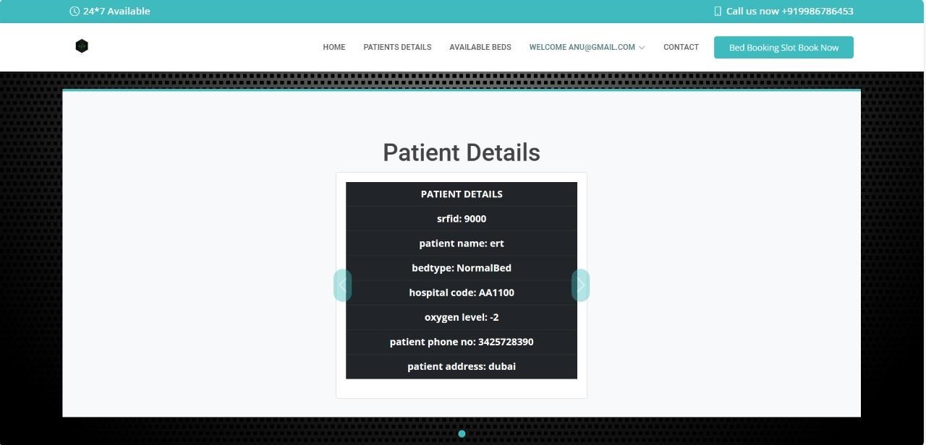
Patient details

Slide 20
CONCLUSION:
The project Hospital management system is for computerizing and for outreach of making the bed available to the infected user or patient and vaccination related queries. The computerization of the system has speed up the process. In present circumstances the management system is very hectic, confusing and a lot of mistakes can be made.

Slide 21
THANKS!

